Slide 1
Queue & Circular Queue in Data Structure

Slide 2
Queue

Slide 3
Queue is also an abstract data type or a linear data structure.
Queue process on the basis of FIFO(First in First Out) in data structure, which means that element inserted first will be removed first.
The process to add an element into queue is called Enqueue and the process of removal of an element from queue is called Dequeue.
Enqueue () : is the operation for adding an element into queue
Dequeue () : is the operation for removing an element from queue

Slide 4
Basic features of Queue
Like stack, queue is also an ordered list of elements of similar data types.
Queue is a FIFO( First in First Out ) structure.
Once a new element is inserted into the Queue, all the elements inserted before the new element in the queue must be removed, to remove the new element.
peek( ) function is oftenly used to return the value of first element without dequeuing it.

Slide 5
Applications of Queue
Queue, as the name suggests is used whenever there need to manage any group of objects in an order in which the first one coming in, also gets out first while the others wait for their turn,
Following are the scenarios:
Serving requests on a single shared resource, like a printer, CPU task scheduling etc.
In real life scenario, Call Center phone systems uses Queues to hold people calling them in an order, until a service representative is free.
Handling of interrupts in real-time systems. The interrupts are handled in the same order as they arrive i.e First come first served.

Slide 6
Implementation of Queue Data Structure
Initially the head(FRONT) and the tail(REAR) of the queue points at the first index of the array (starting the index of array from 0). As there add elements to the queue, the tail keeps on moving ahead, always pointing to the position where the next element will be inserted, while the head remains at the first index.

Slide 7
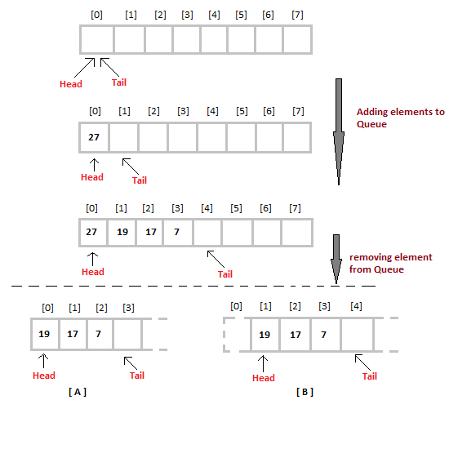

Slide 8
Basic Operations
enqueue() − add (store) an item to the queue.
dequeue() − remove (access) an item from the queue.
peek() − Gets the element at the front of the queue without removing it.
isfull() − Checks if the queue is full.
isempty() − Checks if the queue is empty.

Slide 9
Algorithm
Peek()
Algorithm
begin procedure peek
return queue[front]
end procedure
Implementation of peek() function
Example
int peek() {
return queue[front];
}

Slide 10
isfull()
Algorithm
begin procedure isfull
if rear equals to MAXSIZE
return true
else
return false
endif
end procedure
Example
bool isfull() {
if(rear == MAXSIZE - 1)
return true;
else
return false; }

Slide 11
isempty()
Algorithm :
begin procedure isempty
if front is less than MIN OR front is greater than rear
return true
else
return false
endif
end procedure
If the value of front is less than MIN or 0, it tells that the queue is not yet initialized, hence empty.
Example:
bool isempty() {
if(front < 0 || front > rear)
return true;
else
return false;
}

Slide 12
Algorithm for ENQUEUE operation
Check if the queue is full or not.
If the queue is full, then print overflow error and exit the program.
If the queue is not full, then increment the tail and add the element.
Algorithm for DEQUEUE operation
Check if the queue is empty or not.
If the queue is empty, then print underflow error and exit the program.
If the queue is not empty, then print the element at the head and increment the head.

Slide 13
Algorithm for enqueue operation
procedure enqueue(data)
if queue is full
return overflow
endif
rear ← rear + 1
queue[rear] ← data
return true
end procedure

Slide 14
Example
int enqueue(int data)
if(isfull())
return 0;
rear = rear + 1;
queue[rear] = data;
return 1;
end procedure

Slide 15
Algorithm for dequeue operation
procedure dequeue
if queue is empty
return underflow
end if
data = queue[front]
front ← front + 1
return true
end procedure

Slide 16
Example
int dequeue() {
if(isempty())
return 0;
int data = queue[front];
front = front + 1;
return data;
}

Slide 17
Complexity Analysis of Queue Operations
Just like Stack, in case of a Queue too, on which position new element will be added and from where an element will be removed, hence both these operations requires a single step.
Enqueue: O(1)
Dequeue: O(1)
Size: O(1)

Slide 18
Circular Queue

Slide 19

Circular Queue is also a linear data structure, which follows the principle of FIFO(First In First Out), but instead of ending the queue at the last position, it again starts from the first position after the last, hence making the queue behave like a circular data structure.
In a circular queue, all nodes are treated as circular. Last node is connected back to the first node.
Circular queue is also called as Ring Buffer.
It is an abstract data type.
Circular queue contains a collection of data which allows insertion of data at the end of the queue and deletion of data at the beginning of the queue.

Slide 20
Basic features of Circular Queue
In case of a circular queue, head pointer will always point to the front of the queue, and tail pointer will always point to the end of the queue.
Initially, the head and the tail pointers will be pointing to the same location, this would mean that the queue is empty.

Slide 21
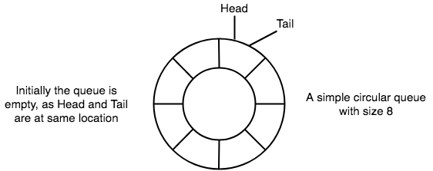

Slide 22
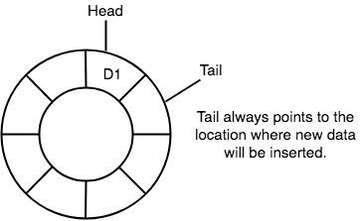
New data is always added to the location pointed by the tail pointer, and once the data is added, tail pointer is incremented to point to the next available location.

Slide 23
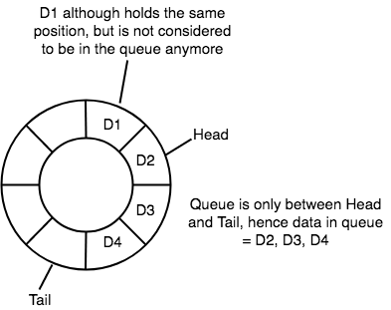
In a circular queue, data is not actually removed from the queue. Only the head pointer is incremented by one position when dequeue is executed. As the queue data is only the data between head and tail, hence the data left outside is not a part of the queue anymore, hence removed.

Slide 24
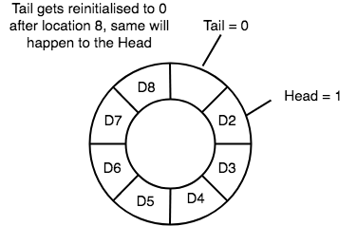
The head and the tail pointer will get reinitialised to 0 every time they reach the end of the queue.

Slide 25
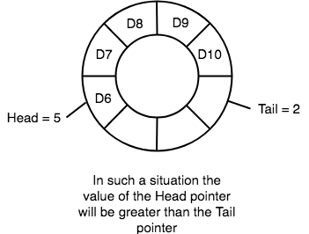
Also, the head and the tail pointers can cross each other. In other words, head pointer can be greater than the tail. Sounds odd? This will happen when we dequeue the queue a couple of times and the tail pointer gets reinitialised upon reaching the end of the queue.

Slide 26
Application of Circular Queue
Below we have some common real-world examples where circular queues are used:
Computer controlled Traffic Signal System uses circular queue.
CPU scheduling and Memory management.

Slide 27
Implementation of Circular Queue
Initialize the queue, with size of the queue defined (maxSize), and head and tail pointers.
Step 1 - Include all the header files which are used in the program and define a constant 'SIZE' with specific value.
Step 2 - Declare all user defined functions used in circular queue implementation.
Step 3 - Create a one dimensional array with above defined SIZE (int cQueue[SIZE])
Step 4 - Define two integer variables 'front' and 'rear' and initialize both with '-1'. (int front = -1, rear = -1)
Step 5 - Implement main method by displaying menu of operations list and make suitable function calls to perform operation selected by the user on circular queue.

Slide 28
enQueue(value) - Inserting value into the Circular Queue
Step 1 - Check whether queue is FULL. ((rear == SIZE-1 && front == 0) || (front == rear+1))
Step 2 - If it is FULL, then display "Queue is FULL!!! Insertion is not possible!!!" and terminate the function.
Step 3 - If it is NOT FULL, then check rear == SIZE - 1 && front != 0 if it is TRUE, then set rear = -1.
Step 4 - Increment rear value by one (rear++), set queue[rear] = value and check 'front == -1' if it is TRUE, then set front = 0.

Slide 29
deQueue(value) – Deleting value from the Circular Queue
Step 1 - Check whether queue is EMPTY. (front == -1 && rear == -1)
Step 2 - If it is EMPTY, then display "Queue is EMPTY!!! Deletion is not possible!!!" and terminate the function.
Step 3 - If it is NOT EMPTY, then display queue[front] as deleted element and increment the front value by one (front ++). Then check whether front == SIZE, if it is TRUE, then set front = 0. Then check whether both front - 1 and rear are equal (front -1 == rear), if it TRUE, then set both front and rear to '-1' (front = rear = -1).

Slide 30
display() - Displays the elements of a Circular Queue
Step 1 - Check whether queue is EMPTY. (front == -1)
Step 2 - If it is EMPTY, then display "Queue is EMPTY!!!" and terminate the function.
Step 3 - If it is NOT EMPTY, then define an integer variable 'i' and set 'i = front'.
Step 4 - Check whether 'front <= rear', if it is TRUE, then display 'queue[i]' value and increment 'i' value by one (i++). Repeat the same until 'i <= rear' becomes FALSE.
Step 5 - If 'front <= rear' is FALSE, then display 'queue[i]' value and increment 'i' value by one (i++). Repeat the same until'i <= SIZE - 1' becomes FALSE.
Step 6 - Set i to 0.
Step 7 - Again display 'cQueue[i]' value and increment i value by one (i++). Repeat the same until 'i <= rear' becomes FALSE.

